Slide 1
Problem solving with graphical representations
Graphical representations

Slide 2
How our teaching resources are designed for the classroom

Slide 3
I can use my knowledge of graphical representations to solve problems.

Slide 4
The relationship between two variables is linear if, when plotted on a pair of axes, a straight line is formed.
The gradient is a measure of how steep a line is.
An intercept is the coordinate where a line or curve meets a given axis.

Slide 5
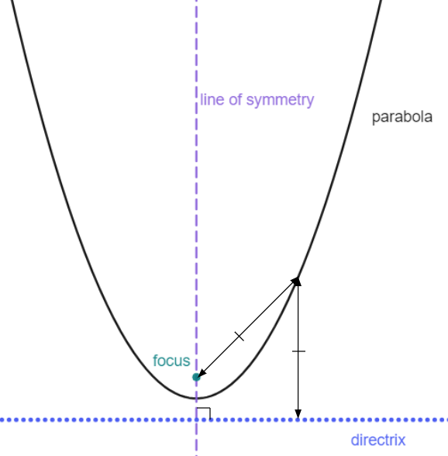
A parabola is a curve where any point on the curve is an equal distance from:
a fixed point (the focus), and
a fixed straight line (the directrix)
The line of symmetry goes through the focus, at right angles to the directrix.

Slide 6

Problem solving with graphical representations
Using sketches to locate intersections
Matching sketches to real-life models

Slide 7



Using sketches to locate intersections
Andeep and Jun are solving equations.
68 − 3x = 2x + 18
I’ve got the solution x = 10
But, I’ve got the solution x = −50
Our teacher has told us that one of us is right but we’re not sure who!
How would you help them?

Slide 8
Using sketches to locate intersections
Andeep and Jun are solving equations.
68 − 3x = 2x + 18
I’ve got the solution x = 10
But, I’ve got the solution x = −50
Substitution is one way to help identify who is right. Only Andeep’s solution makes the equation balance.
68 − 3(10) = 2(10) + 18
But there is another way. And we mathematicians like multiple methods for solving the same problem!

Slide 9
Using sketches to locate intersections
A simple sketch of these two equations will help us to approximately locate the solution.
68 − 3x = 2x + 18
y
y = 2x + 18
y-intercept (0, 18)
(0, 68)
✖
Gradient +2
y = 68 − 3x
(0, 18)
✖
y-intercept (0, 68)
x
Gradient −3

Slide 10
Using sketches to locate intersections
A simple sketch of these two equations will help us to approximately locate the solution.
68 − 3x = 2x + 18
y
(0, 68)
Our sketch shows us that the lines intersect in the first quadrant
Our sketch shows us that the lines intersect in the first quadrant therefore the solution must be positive.
✖
(0, 18)
✖
x

Slide 11
Using sketches to locate intersections
A simple sketch of these two equations will help us to approximately locate the solution.
68 − 3x = 2x + 18
y
We can see that the solution has to be positive. It must be mine, x = 10
(0, 68)
✖
(0, 18)
✖
x

Slide 12

Using sketches to locate intersections
This sketch tells us what about the solution to this equation?
8x + 128 = 39 − 4x
y
The solution is positive.
✖
(0, 128)
The solution is negative.
✖
(0, 39)
x values in the second quadrant are negative.
There is no solution.
x

Slide 13
Using sketches to locate intersections
A sketch can also help us to approximate the location of
the intersection when solving pairs of simultaneous equations.
10x + 6y = 30
When x = 0, y = 5
y
When y = 0, x = 3
✖
(0, 5)
2x + 5y = −10
When x = 0, y = −2
When y = 0, x = −5
Our sketch locates the intersection in the fourth quadrant.
The solution to this pair of simultaneous equations must be a positive x value and a negative y value.
(3, 0)
x
✖
✖
(−5, 0)
✖
(0,−2)

Slide 14
Using sketches to locate intersections
The solution to this pair of simultaneous equations is in which quadrant?
6y − 10x = 30
y
2x + 5y = −10
The second quadrant.
✖
(0, 5)
(−3, 0)
The third quadrant.
✖
✖
x
(−5, 0)
✖
(0,−2)
The fourth quadrant.

Slide 15
Using sketches to locate intersections
Our solution is in the third quadrant. What does that tell us about our solution?
6y − 10x = 30
y
2x + 5y = −10
The x value is negative, y is positive.
✖
(0, 5)
The x value is negative, y is negative.
(−3, 0)
✖
✖
x
x and y values are negative in the third quadrant.
(−5, 0)
✖
(0,−2)
The x value is positive, y is negative.

Slide 16
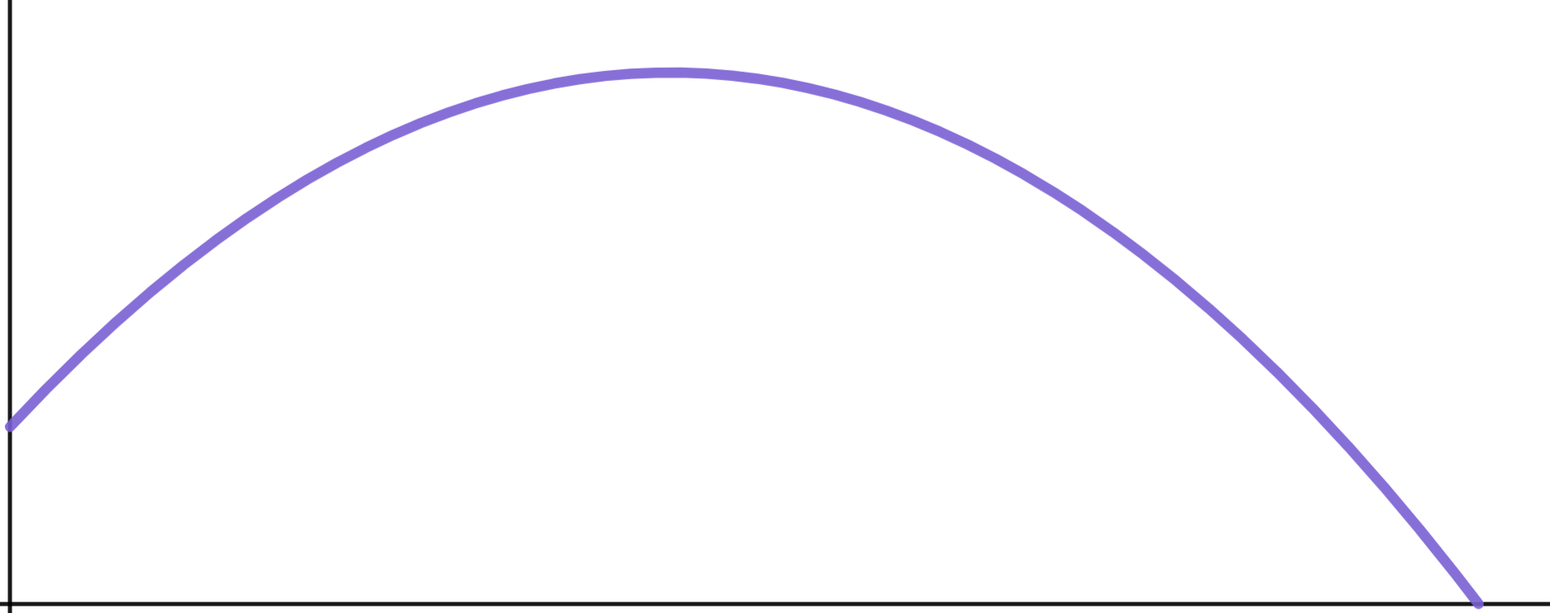

Using sketches to locate intersections
It’s not just sketches of linear equations that solve problems.
Laura sketches this parabola to model her throw of a cricket ball.
h
✖
(16, 8)
A good sketch always contains important values.
✖
(0, 1.5)
(36, 0)
✖
d

Slide 17
Using sketches to locate intersections
We can draw a line of h = 6 metres to ascertain how many times the ball was six metres above the ground.
h
Two intersections tell us there were two moments when the ball was six metres above the ground.
✖
(16, 8)
h = 6
✖
✖
✖
(0, 1.5)
(36, 0)
✖
d

Slide 18
Using sketches to locate intersections
What does this line h = 10 tell us?
No intersections tells us the ball never reached a point where it was 10 m above the ground.
h
h = 10
✖
(16, 8)
✖
(0, 1.5)
(36, 0)
✖
d

Slide 19
Using sketches to locate intersections
1) Sketch two lines for each equation to decide if the solution is positive or negative.
a) 15 − 9x = 6x + 31
b) 9 − 15x = 6x − 31
Don’t forget to label key features like the y-intercept.

Slide 20
Using sketches to locate intersections
2) What equations does this sketch help us to solve and what can we see about the solution?
Write at least two sentences.
y
5y − 3x = 15
✖
(0, 3)
(0, −3)
x
✖
✖
(0,−5)
(0,−2)
✖
2x + 3y = −6

Slide 21
Using sketches to locate intersections
3) Draw appropriate lines on this graph and identify intersections to answer these questions about Laura’s improving cricket throw.
a) How many times was the ball at a height of 5 m ?
h
✖
(20, 10)
b) How many times was the ball at a height of 1 m ?
✖
(0, 1.5)
(45, 0)
c) How many times was the ball at a height of 10 m ?
✖
d

Slide 22
Using sketches to locate intersections
1) Sketch two lines for each equation to decide if the solution is positive or negative.
a) 15 − 9x = 6x + 31
b) 9 − 15x = 6x − 31
y
y
Intersection in the second quadrant, solution for x must be negative.
(0, 31)
Intersection in the fourth quadrant, solution for x must be positive.
(0, 9)
✖
✖
x
✖
(0, 15)
(0,−31)
✖
x

Slide 23
Using sketches to locate intersections
2) What equations does this sketch help us to solve and what can we see about the solution?
y
5y − 3x = 15
You might have written, “This sketch shows us that the intersection of the pair of simultaneous equations
✖
(0, 3)
(0, −3)
x
5y − 3x = 15
✖
✖
(0,−5)
2x + 3y = −6
(0,−2)
✖
lies in the second quadrant.
For the solution the x value must be negative and the y value positive.
2x + 3y = −6

Slide 24
Using sketches to locate intersections
3) Draw appropriate lines on this graph and identify intersections to answer these questions about Laura’s improving cricket throw.
a) How many times was the ball at a height of 5 m ?
h
h = 10
✖
✖
Two intersections therefore twice.
(20, 10)
h = 5
b) How many times was the ball at a height of 1 m ?
✖
✖
✖
(0, 1.5)
h = 1
One intersection therefore once.
✖
(45, 0)
c) How many times was the ball at a height of 10 m ?
✖
d
One intersection therefore once.

Slide 25
Problem solving with graphical representations
Using sketches to locate intersections
Matching sketches to real-life models

Slide 26
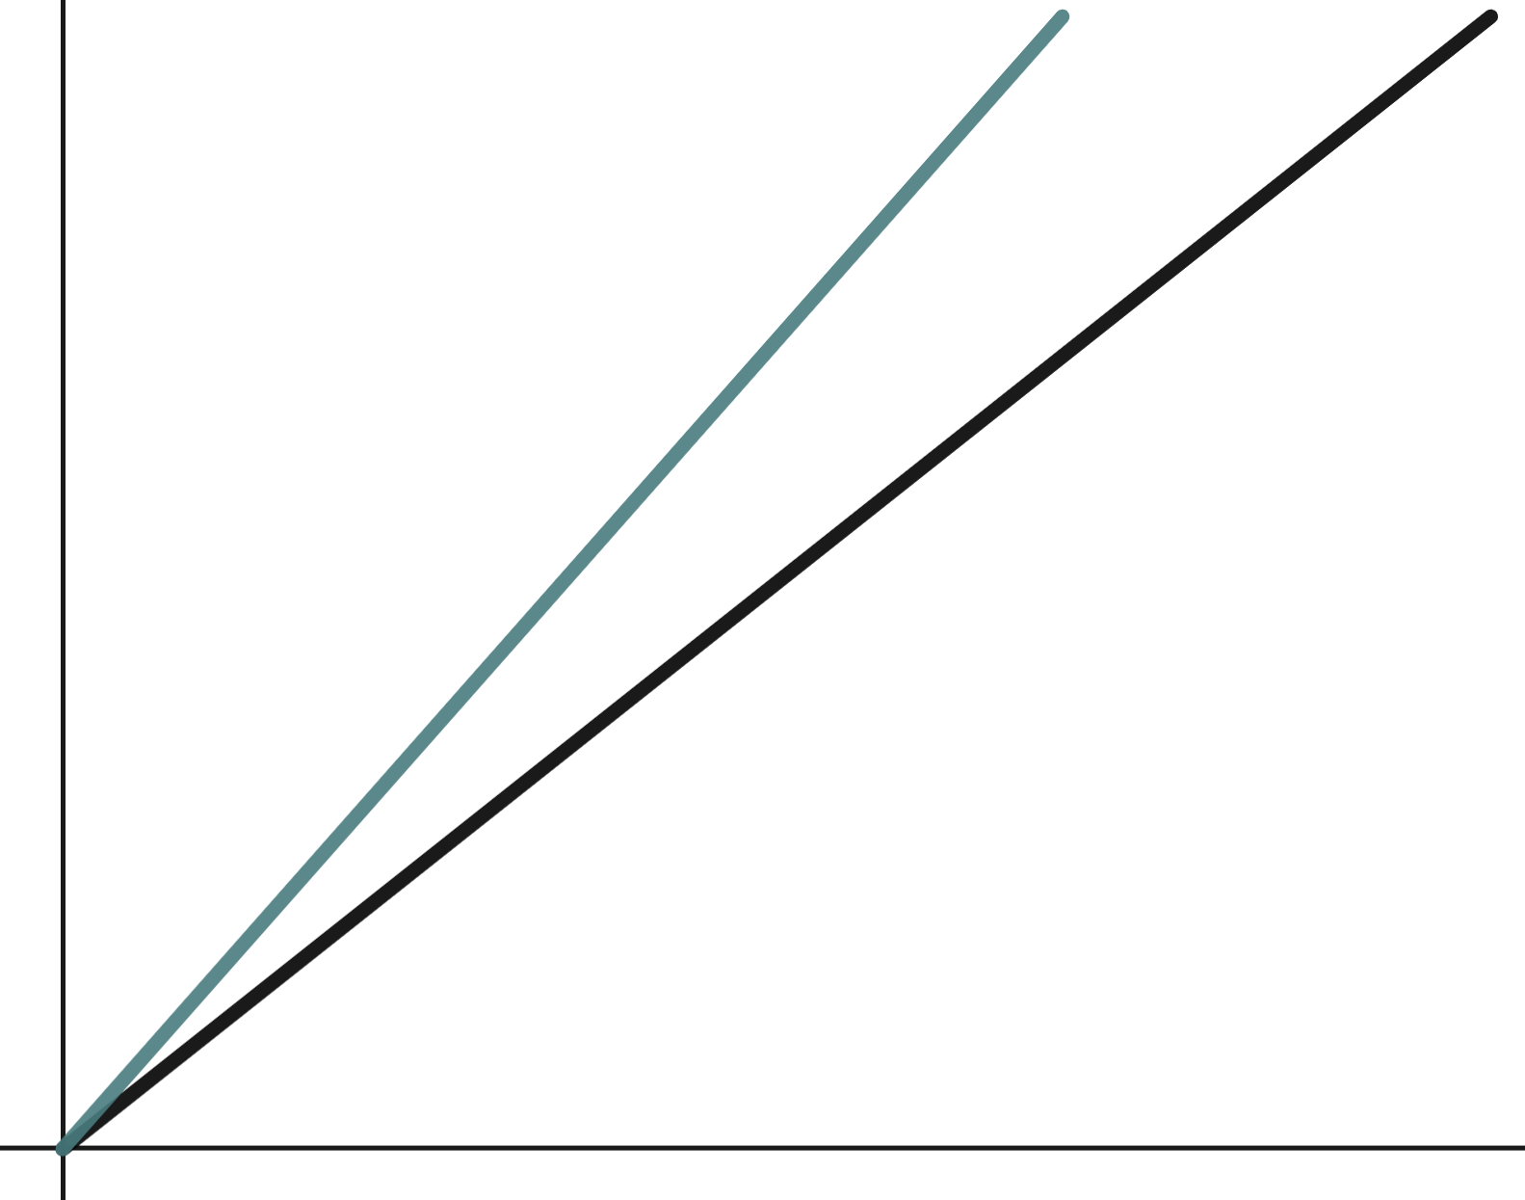

Matching sketches to real-life models
Sometimes we need to use our understanding of
mathematics to be able to match models to real-life scenarios.
These models are from a race we do in PE. One model is from today, the other from a few years ago.
distance
Can you tell which is which?
time
Sofia

Slide 27
Matching sketches to real-life models
Sometimes we need to use our understanding of
mathematics to be able to match models to real-life scenarios.
These models are from a race we do in PE. One model is from today, the other from a few years ago.
distance
Today
A few years ago
The line with the steeper gradient means a faster speed therefore we can assume that one is from today.
time
Sofia

Slide 28
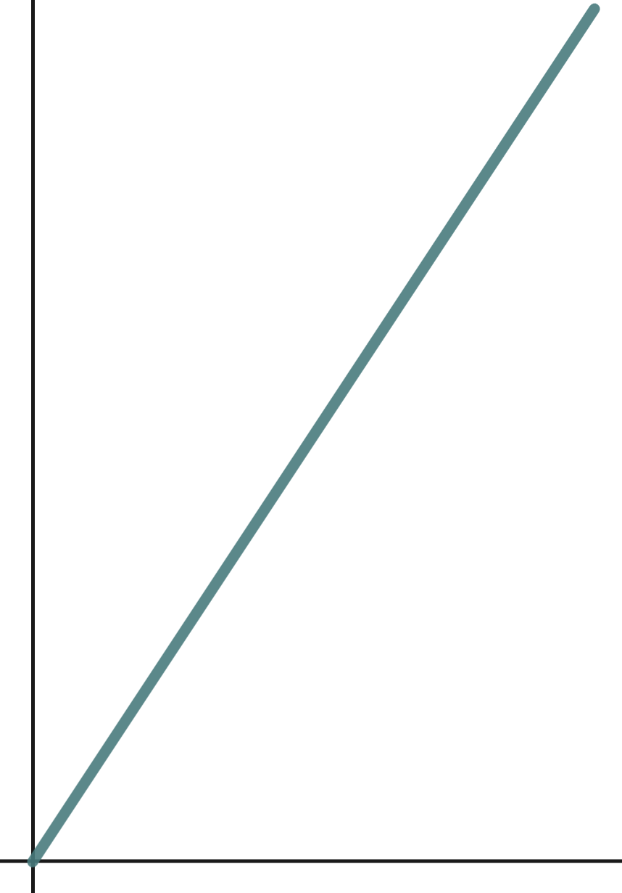

Matching sketches to real-life models
Alex also has two graphs to represent his time today and his time from a few years ago.
distance
distance
time
time
There looks like there is no difference. Alex has made no improvement.

Slide 29
Matching sketches to real-life models
Good sketches in maths include some important values.
When we add these to Alex’s graph we can tell which is which.
distance
distance
time
time

Slide 30
Matching sketches to real-life models
Good sketches in maths include some important values.
When we add these to Alex’s graph we can tell which is which.
100
100
distance
distance
50
50
time
time
7
14
10
20
This information now shows us that the graph on the left is Alex’s new, improved race.

Slide 31

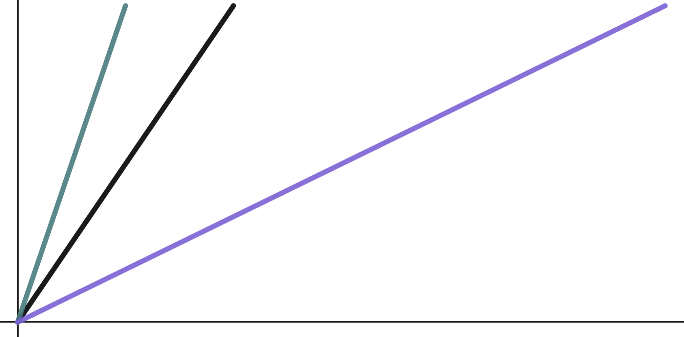
Matching sketches to real-life models
These models show the time taken for the first 50 m of a race.
Which one shows the fastest time?
a
b
c
The steepest gradient reflects the fastest speed.
distance
time

Slide 32
Matching sketches to real-life models
In real-life distance time models we will see curved lines.
This graph shows a pupil running a 200 m race on sports day.
What is happening here and how do you know?
distance
The gradient is getting less steep which tells us that the pupil is slowing down.
time

Slide 33
Matching sketches to real-life models
In real-life distance time models we will see curved lines.
This graph shows a pupil running a 200 m race on sports day.
Slow
Their race goes through several identifiable periods.
Slowing
distance
Fast
Accelerating
time

Slide 34
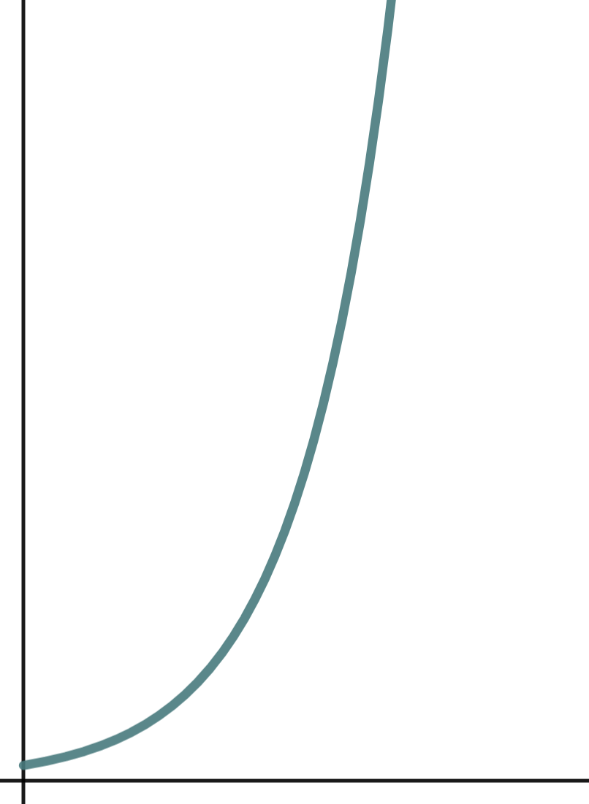
Matching sketches to real-life models
A firework being let off is being modelled by the distance time graph. What is happening to it?
It has a constant speed.
distance
It is accelerating (getting faster).
A constantly increasing gradient on a distance time graph reflects acceleration.
It is decelerating (getting slower).
time

Slide 35
Matching sketches to real-life models
1) Use these blank axes to draw three race events.
a) A short distance, fast race run at a constant speed.
distance
b) A middle distance, medium pace race run at a constant speed.
c) A long distance, slow race run at a constant speed.
time
You need not label the axes.

Slide 36
Matching sketches to real-life models
2) This graph shows two animals running.
One is a human, one is a cheetah.
Identify which line represents which and explain how you know?
distance
Point to more than one key moment in the graph to support your explanation.
time

Slide 37
Matching sketches to real-life models
1) Use these blank axes to draw three race events.
a) A short distance, fast race run at a constant speed.
c)
Short distance. Fast speed.
distance
b)
b) A middle distance, medium pace race run at a constant speed.
a)
Middle distance. Medium speed.
c) A long distance, slow run at a constant speed.
time
Longest time, longest distance. Slow speed.

Slide 38
Matching sketches to real-life models
2) This graph shows two animals running.
One is a human, one is a cheetah.
Full stop after exhausting their explosive energy.
Identify which line represents which and explain how you know?
Cheetah
distance
Human
Faster acceleration, faster top speed.
Slower animal but able to maintain a steady, constant speed for long periods.
time

Slide 39
Matching sketches to real-life models
2) This graph shows two animals running.
One is a human, one is a cheetah.
This intersection is reassurance that you can outrun a Cheetah…
Cheetah
✖
distance
Human
time
Provided you last this long!

Slide 40
Problem solving with graphical representations
Our knowledge of graphical representations can help us to solve a variety of problems from identifying the locations of intersections on graphs in solving equations, to real-life problems involving working with gradients on distance time graphs.

Slide 41

© Oak National Academy 2024.
Produced in partnership with Mathematics in Education and Industry.
Licensed on the Open Government Licence v3.0, except where otherwise stated. See Oak terms and conditions.

